Slide 1
Galatians 2:20 I am crucified with Christ: nevertheless I live; yet not I, but Christ liveth in me: and the life which I now live in the flesh I live by the faith of the Son of God, who loved me, and gave himself for me.

Slide 2
GUARDIANS OF GOD’S HERITAGE
christianity
jeremiah 31:3
PSALM 127:1–5

Slide 3
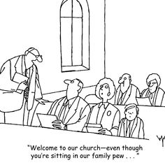

Slide 4
Lesson 1: Convoluted Christianity
1. Understand how God sees us as part of His bride.
2. Learn who the main culprits for confusion of Christianity are.
3. Recognize that Jesus came not to give a religious system, but to give abundant life with a personal relationship with God.

Slide 8
Conclusion
John 10:10
The thief cometh not, but for to steal, and to kill, and to destroy: I am come that they might have life, and that they might have it more abundantly.

